Slide 1

Virtual Backdrop
HCL/CprE 575
Nichole Dugan
Edward Jezisek
Brian Schulte

Slide 2
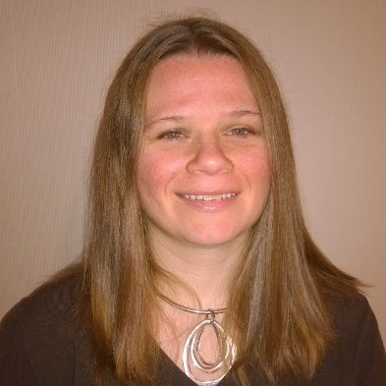
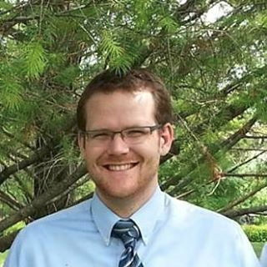
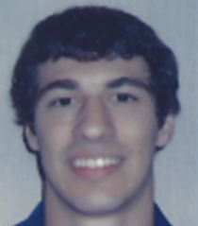
The Team!
Nichole Dugan
Edward Jezisek
Brian Schulte
The Creative!
Just Another Developer
The Systems Guy!
Nicole Dugan is the Creative Expert of Virtual Backdrop. She has specific expertise with respect to the Drivers License Renewal Process in the state of Iowa and is an accomplished programmer. She has developed several consumer based products for the Department of Transportation.
Edward Jezisek is just another developer at Virtual Backdrop. He has created several successful Android Applications featured on Fox News and XDA-Developers. He is currently a programmer for Verizon and is incredibly interested in Algorithms, Data Structures overall Systems Architecture and learning more.
ejezisek@iastate.edu
Brian Schulte has made his career out of developing embedded based products for General Dynamics. He currently volunteers at a high school robotics club and has a vast array of programming experience. He is Virtual Backdrop's Embedded Expert.

Slide 3

Improving the DMV Experience!
Virtual Backdrop
What if any photo could be your driver’s license photo?
Have to go to a station to get your driver’s license photo
Have to have a backdrop in order to get federal standards

Slide 4
Our Lucky Audience
Eligible driver’s license and ID holders in the state of Iowa
18 to 70 years old
Renewing or updating
Younger generations (18-30)
Thrive in a culture of mobile development
Tend to choose self-service over in person interactions
Residents who prefer to avoid the DMV

Slide 5
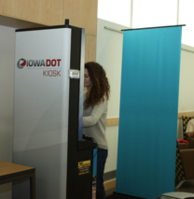
Why this is needed
Customers complain about their license photos
Allows for flexibility and customer choice
Kiosks in Iowa could take up less space if they didn’t have to use a backdrop

Slide 6
Previous Attempts
Current algorithms have some flaws
Vendor current solution has problems with including subject’s hair in the background

Slide 7
Related work
MorphoTrust USA
Patent for virtual backdrop

Slide 8
Opportunities
OpenCV and background identification
OpenCV has a good framework for identifying backgrounds
Using video may improve the quality of detecting the background
Team’s experience can help us solve this problem

Slide 9
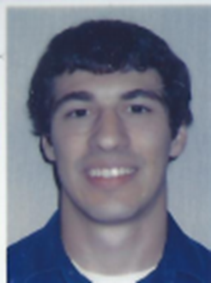

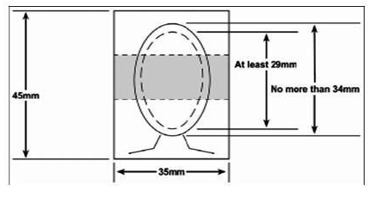
Project Phases
Phase I
Allow users to capture video and upload photos
Phase II
Remove and replace background
Phase III
Integrate virtual backdrop into an Android application
Phase IV
Add ICAO requirement checks
Brian Schulte

Slide 10
Project Concept
C++
OpenCV
v3.1.0
Android application
Version Control
GitHub

Slide 11
Testing
Each of our team members will test the application locally
Will test with already uploaded photos also
Will test on different backgrounds
Photos will be evaluated based on how well the background is removed

Slide 12
Definition of Success
Code removes background image and places a blue background on the photo
Hair is not blended into the background
Application is deployable on android devices meeting application requirements
Stretch Goal
Output photo meets ICAO standards

Slide 13
Questions?
Please submit questions to us via BlackBoard
Nichole Dugan
Edward Jezisek
Brian Schulte
Notes:
This concludes our project presentation. If you have questions, you may contact any of us via black board.

